Slide 1
TWTB Filter

Slide 2
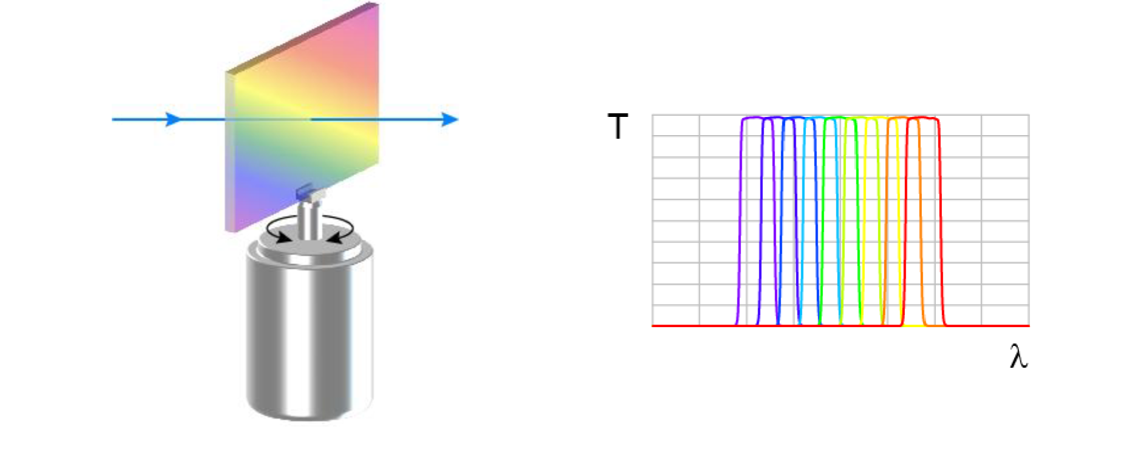
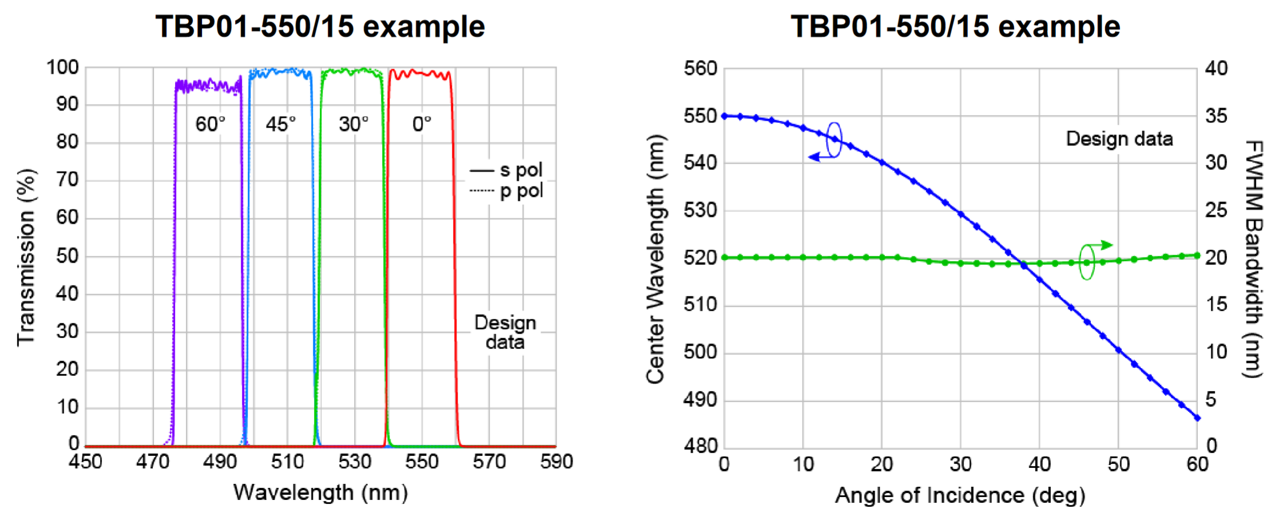
Interference filters
Interference filters have a tunable wavelength but a (nearly) constant bandwidth

Slide 3
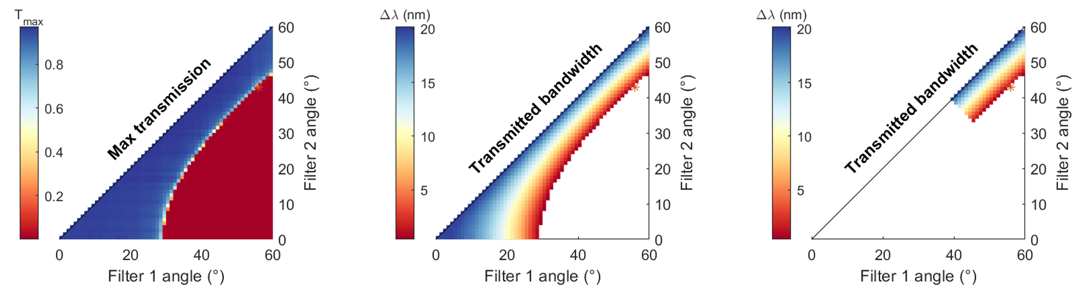
Tunable bandwidth with 2 interference filters
Stack filters! With 2 bandpass we can have tunable bandwidth tunable wavelength

Slide 4
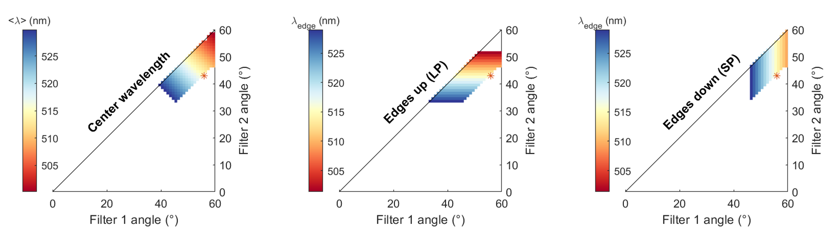
Tunable bandwidth tunable wavelength filter
Zoom-in view of the center wavelengths of interest
ROI

Slide 5
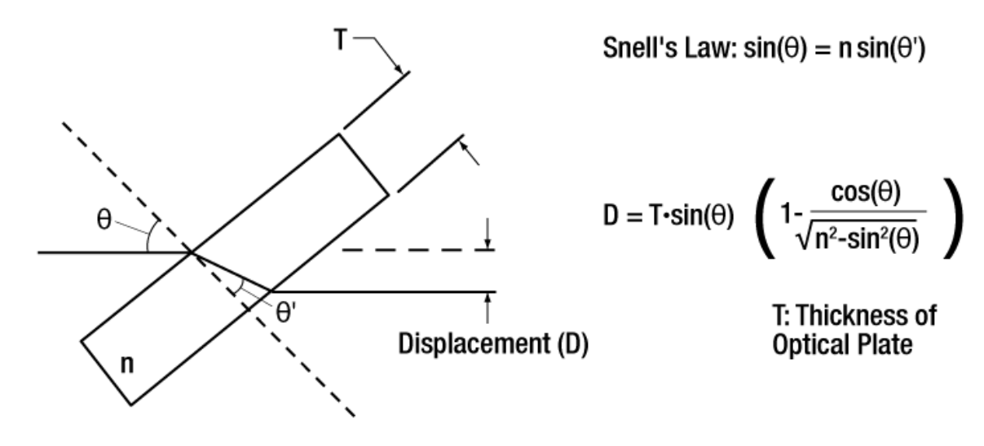
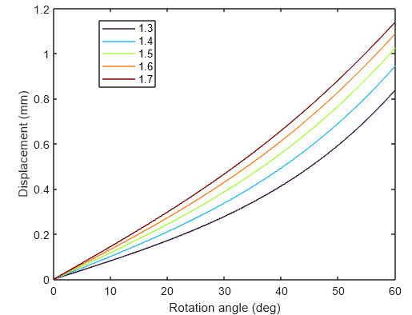
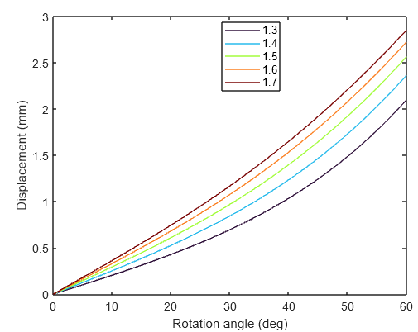
Beam displacement

Slide 6
Minimise beam displacement
Put filters in this configuration to minimise displacement
Turn one clockwise and one counterclockwise

